Slide 1

Dynamic Generation of Modular Industrial Plant Visualizations
Weekly Meeting 10
Miguel Romero Karam

Slide 2
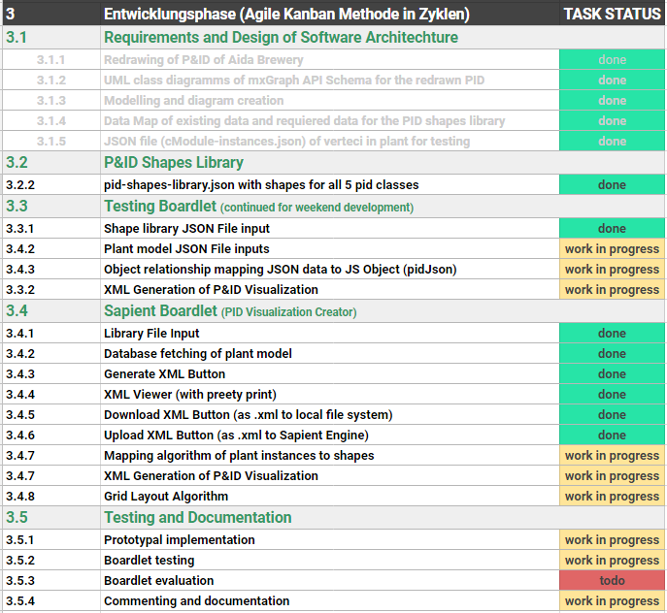
Task Backlog – Overview Overview of tasks: Week 10
UPDATE

Slide 3
Task Backlog – Overview Overview of tasks: Week 10
UPDATE

Slide 4
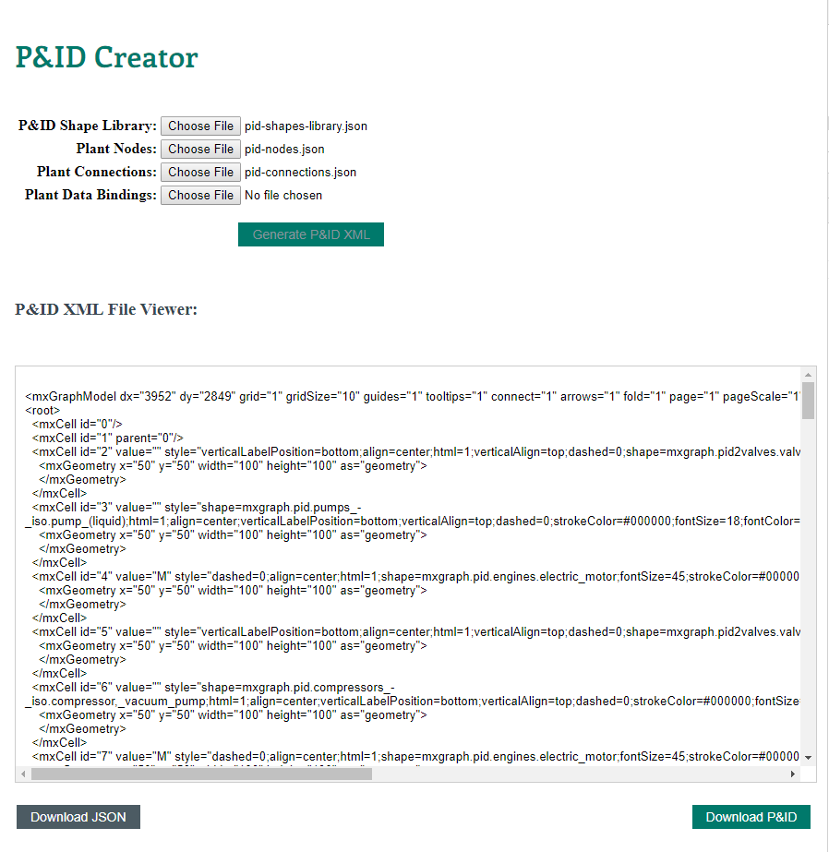
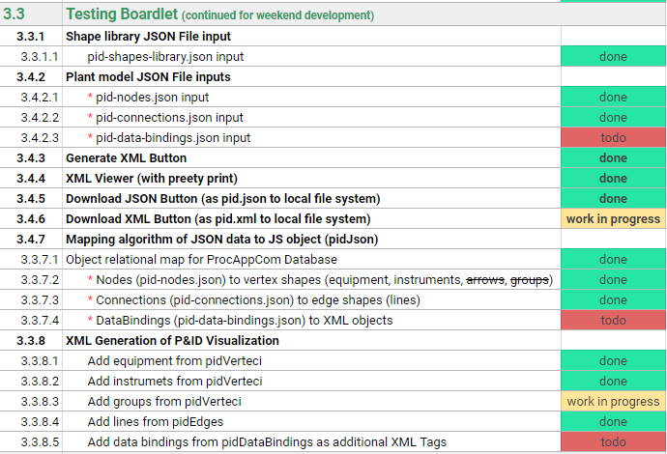
Testing Boardlet Weekly Sprint 10
UPDATE
In client- background

Slide 5


Task Backlog – Overview Overview of tasks: Week 10
UPDATE

Slide 6
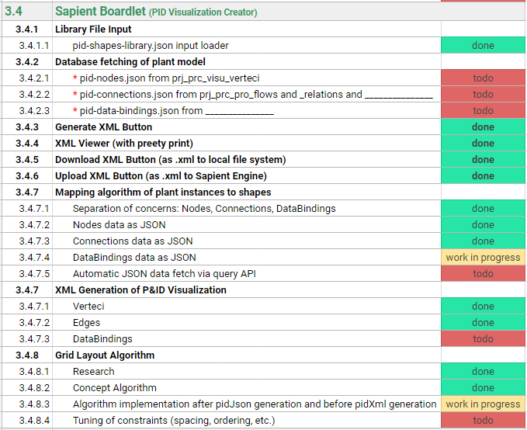
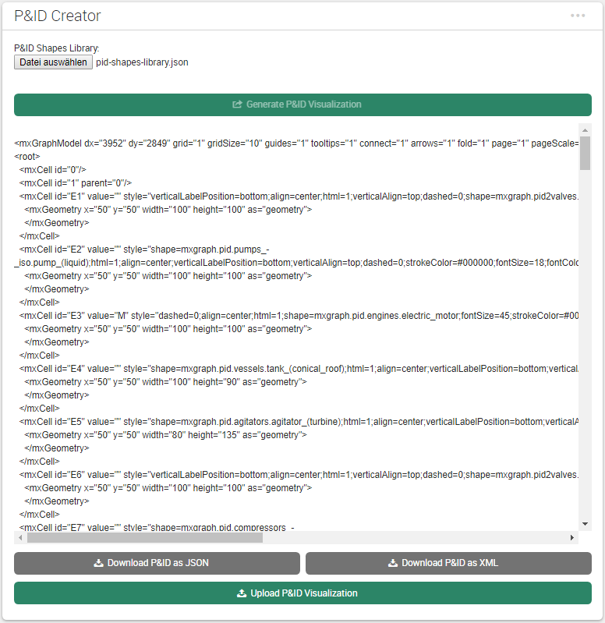
Sapient Boardlet Weekly Sprint 10
1
1
2
In client- background
3
2
UPDATE
3
4
5
In client- background
4
4
5

Slide 7
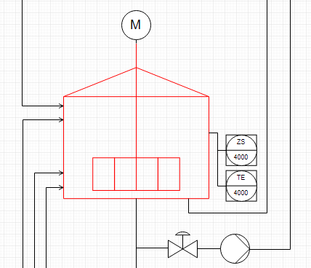
3.4.8 – Vertex Layout Algorithm Concept
Instance Hierarchy Traversal
Instance Hierarchy in model via parent attribute.
Once cModule layer reached, work with place all inside parent.
When done, move to parent’s next children.
Repeat.
Enterprise : AIDA Cruises
1
Site : AIDA
2
Area : Brewery
3
Brewhouse : Process Cell
4
Unit : U_L2
5
U_M5
1
U_P3
5
U_W3
1
EModule : Water_injection
6
Stem_ heating
11
16
…
…
…
…
…
…
…
…
…
…
…
…
…
CModule :
6
7
8
9
10
12
13
14
15
…
…
…
…
…
…
…
Control_valve_440
Pump_P40
Motor
Kettle_sensor_Z
Kettle_sensor_T

Slide 8
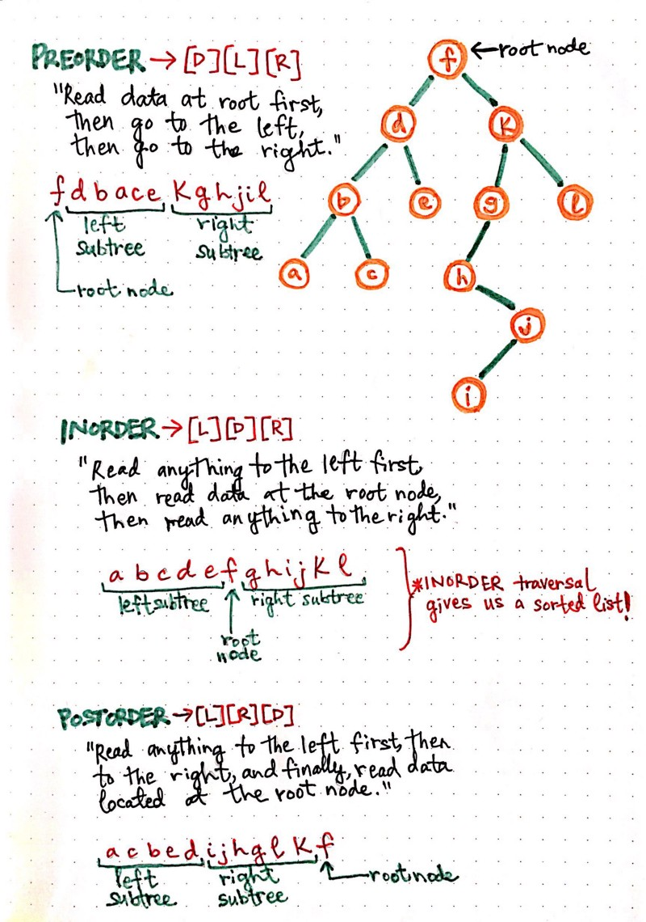
3.4.8 – Vertex Layout Algorithm Concept
Tree (hierarchy) traversal methods
Preorder [D][L][R]
Inorder [L][D][R]
Postorder [L][R][D]
Vertex placement, then next vertex placement, then next vertex placement, … , finally group placment
https://medium.com/basecs/demystifying-depth-first-search-a7c14cccf056

Slide 9


3.4.8 – Vertex Layout Algorithm Concept
Vertex Placement
Depth-first traversal of instance hierarchy (IH) via parent attribute until cModule.
Vertex placement inside group: relative positioning with constraints
Rules for example: if (valve to instrument) : instrument above valve
Implement units and cModules as groups (containers) with mxGraph API.
Count units to construct general grid layout.
Geometry between neighbouring children
$$x=w_{p}+s$$
y$=h_{p}−$ $h_{n}$
wn/2
wp/2
(x, y)
hn/2
hp/2
(0, 0)
spacing
Hgmax (currently)
$$r$$
Wgmax (currently)
Relative Positioning
vertex placement group placement group placement … (recursively)
Parent vertex
(0, 0)
(-0.5,0.5)
(0.5, 0.5)
(1, 1)

Slide 10
Issues and challenges Weekly Sprint 10

Slide 11
Next Sprint Weekly Sprint 10

